Slide 1
Introduction to Reverse Engineering with Ghidra: Taming the Dragon
Christopher Doege

Slide 2

About Me…
Cyber Software Engineer at Raytheon
Enjoy crypto and reversing
CTF player
NASA Rejects

Slide 3

What is Reverse Engineering?
Many forms (focusing on binary reverse engineering)
Compiled code -> ASM
Useful for figuring out how binaries work
Malware, CTFs, VR, etc.

Slide 4
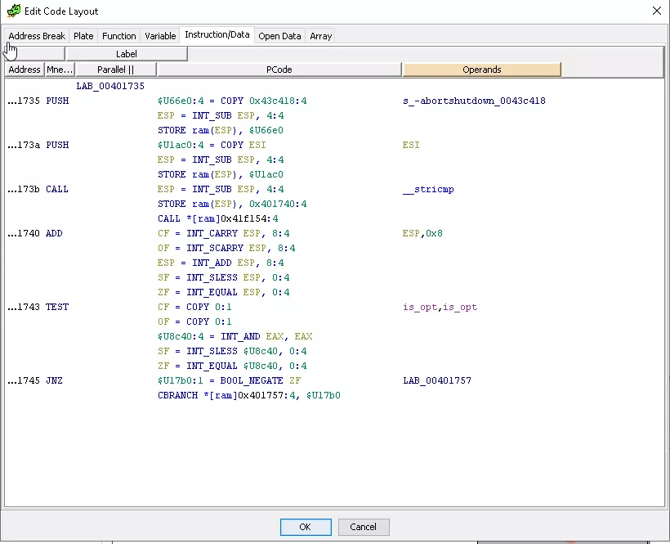
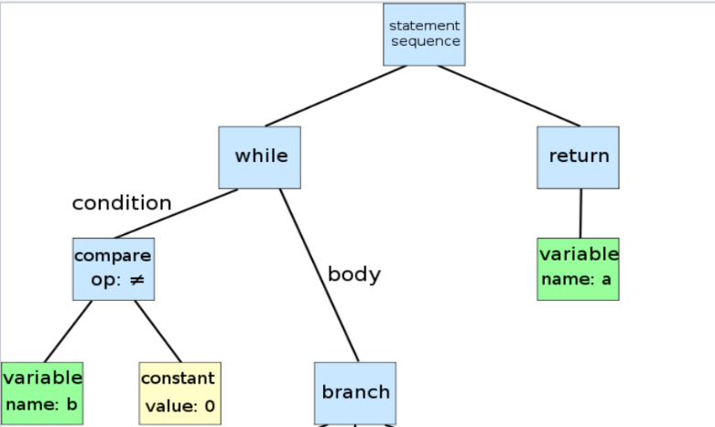
Introduction to Reversing Topics (Static Analysis)
Reverse Engineering
Static (focus of this talk)
Dynamic
Disassembling
Byte-code -> assembly
Decompilation
ASM -> IL -> “C-like syntax”

Slide 5
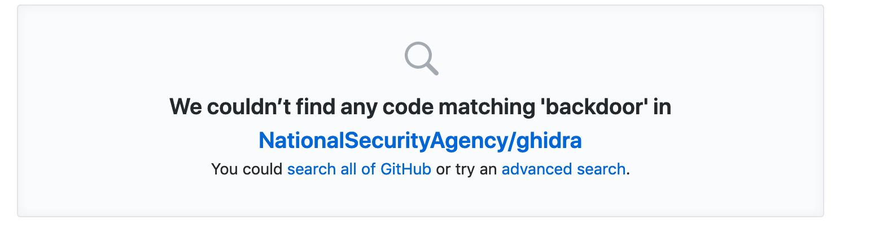
What is Ghidra?
“Gee-druh”
Software reverse engineering tool with version management / decompilers
Repo on github with active contributions / maintainers
Multi-platform (Linux, OSX, Windows)

Slide 6
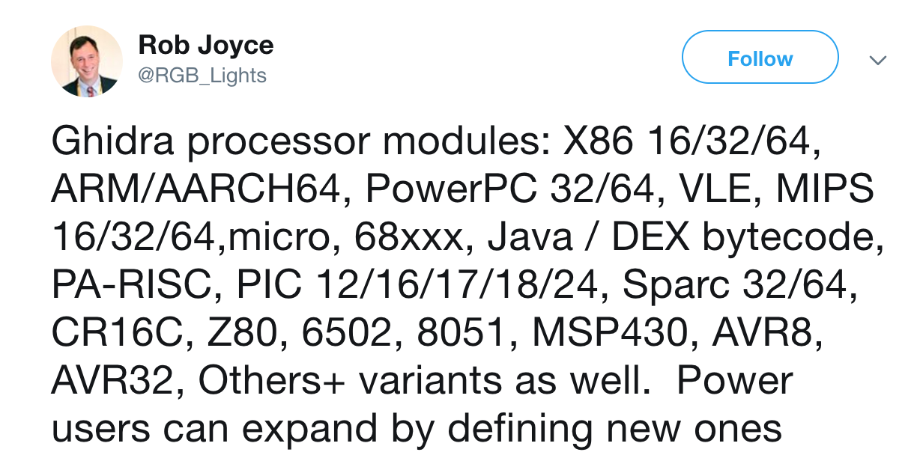
Supported Architectures

Slide 7
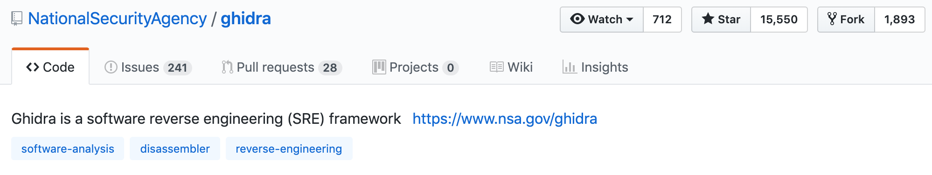
Downloading Ghidra
https://ghidra-sre.org
https://github.com/NationalSecurityAgency/ghidra
Can build from source

Slide 8
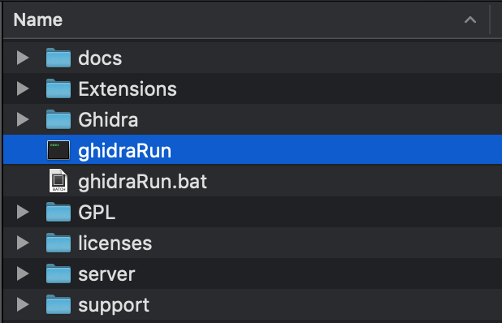
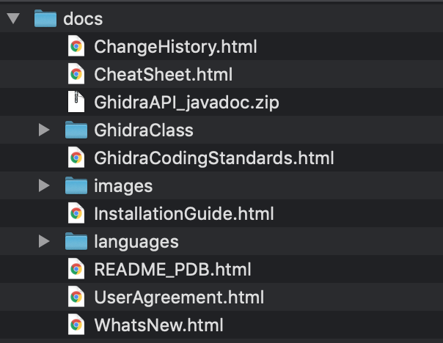
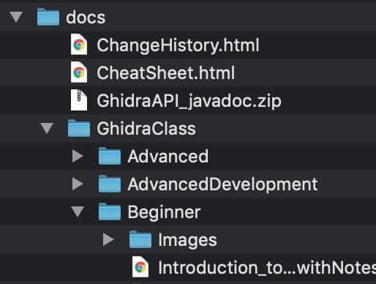
What’s Inside the Box?

Slide 9
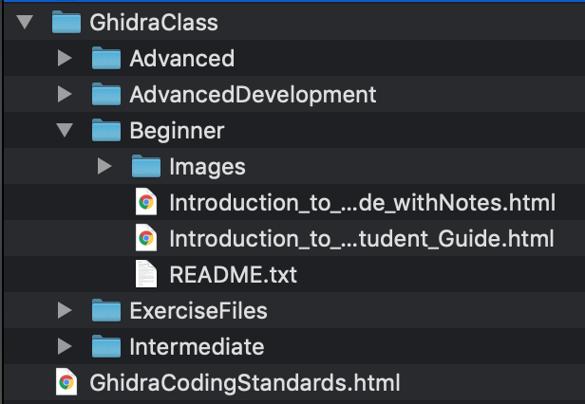
Ghidra Trainings

Slide 10
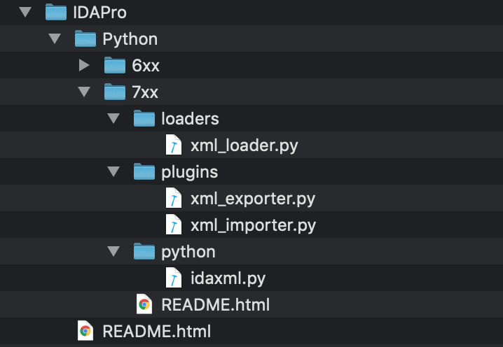
IDA Database Conversion Tools

Slide 11
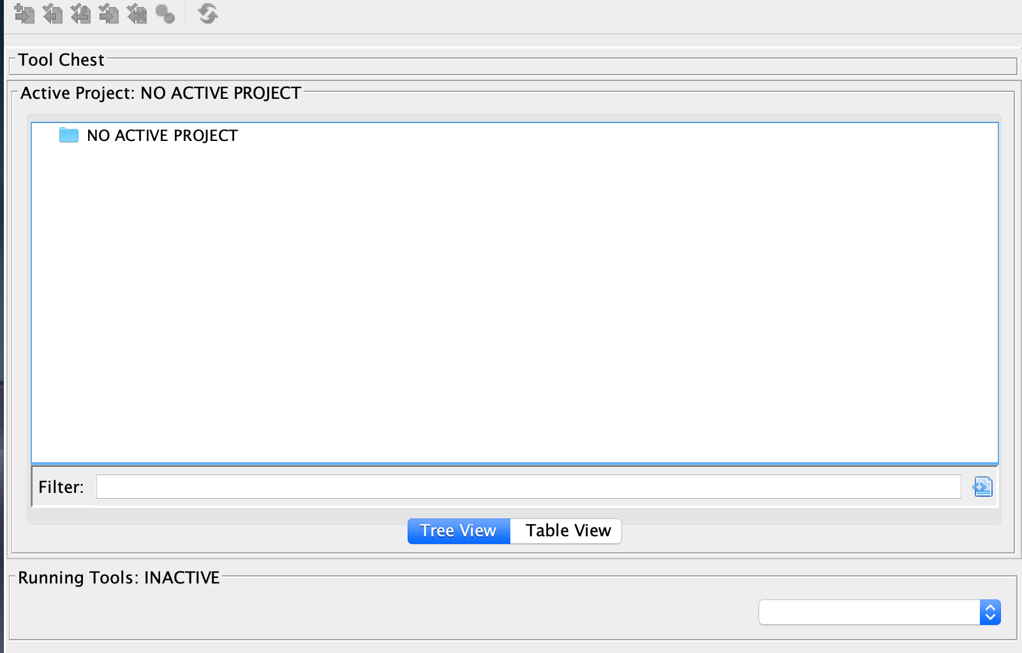
Getting Started with Ghidra

Slide 12
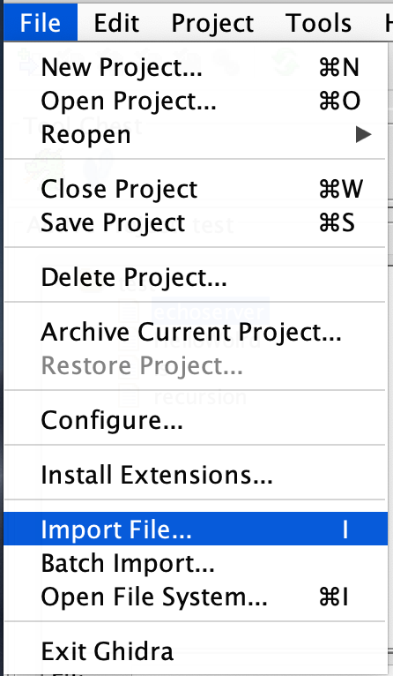
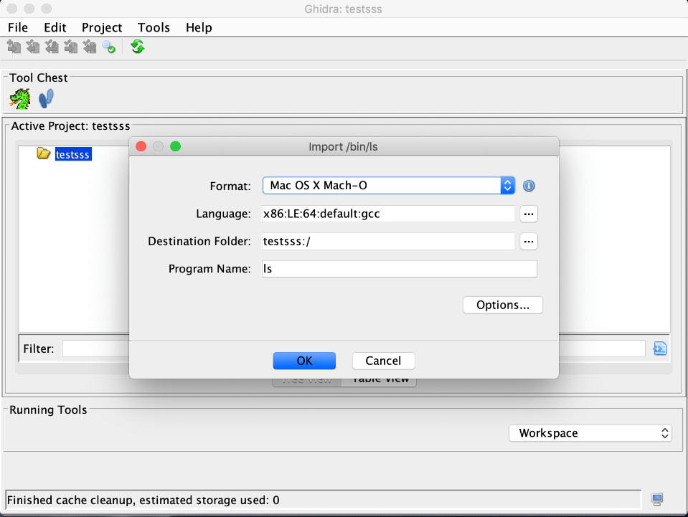
Adding Binaries
File -> Import File
Keyboard shortcut (i)
Can also add .so to map references

Slide 13
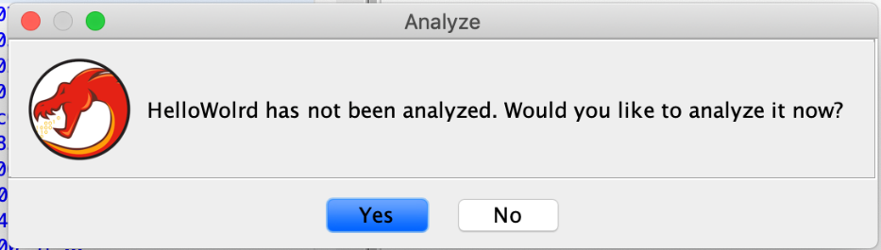
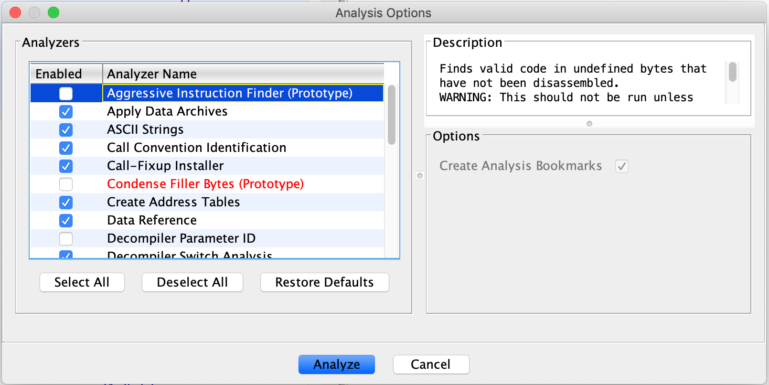
Automated Analysis

Slide 14
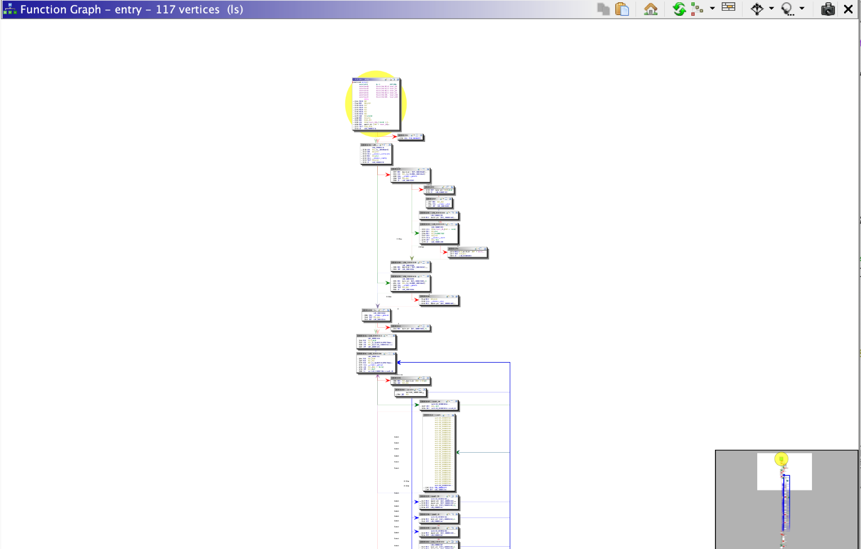
Graph View

Slide 15
Server Collaboration
Git-like collaboration
Commit changes to the database back to the server
Review changes made by others
Version history
Use cases
Useful for CTFs
Mentoring for RE
Group malware reversing efforts

Slide 16
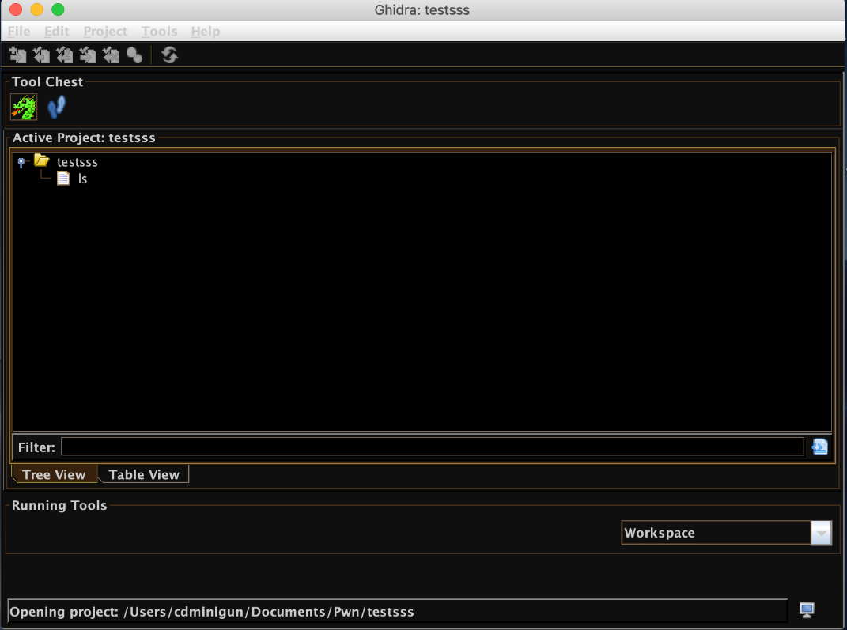
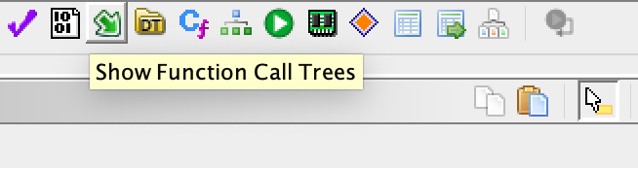
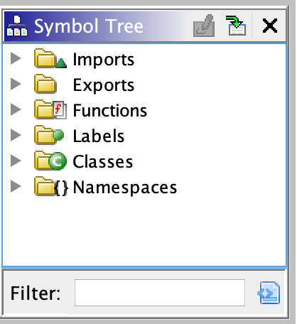
Useful Features
Themes and configurations
Handling XREFs / function call trees
Navigating the symbol tree
Mod + e

Slide 17
Useful Plugins
https://github.com/0ffffffffh/dragondance
Like Lighthouse for Ghidra
Used to visualize and manipulate binary code coverage
https://gist.github.com/adulau/a3a0eefb7828d52747a9d247a82eeeef
“Ghidra Community”
List of plugins/CPU extensions for Ghidra
https://github.com/daenerys-sre/source
Allows execution of IDA scripts in Ghidra and Ghidra scripts in IDA

Slide 18
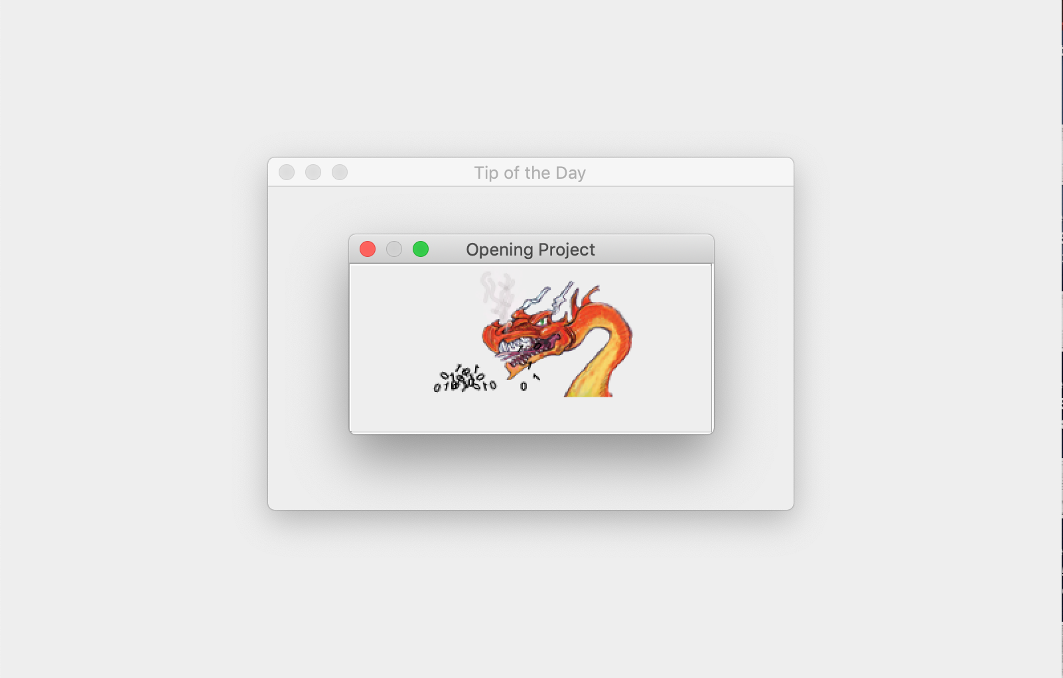
Ghidra Demos

Slide 19
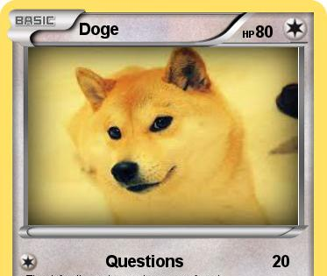
Conclusion / Questions?

Slide 20


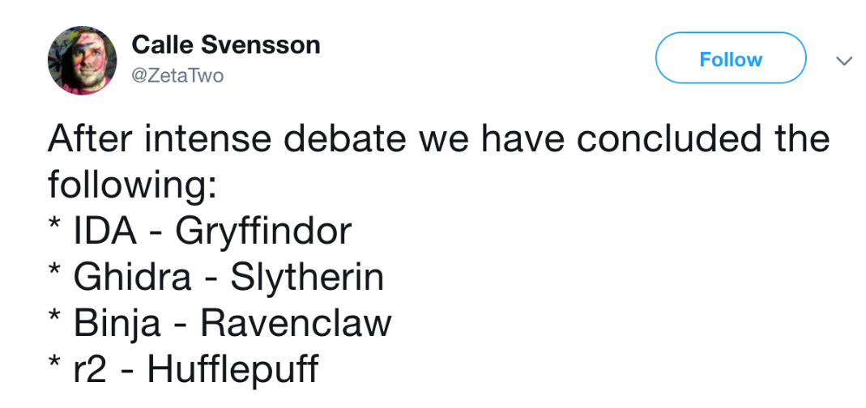
Memes

Slide 21

Thank You!
christopher.k.doege@raytheon.com
@Chris_Doege

